Slide 1
Power bi capstone - 2
A.Sai Akhilesh

Slide 2


Topic Predicting diabetes

Slide 3
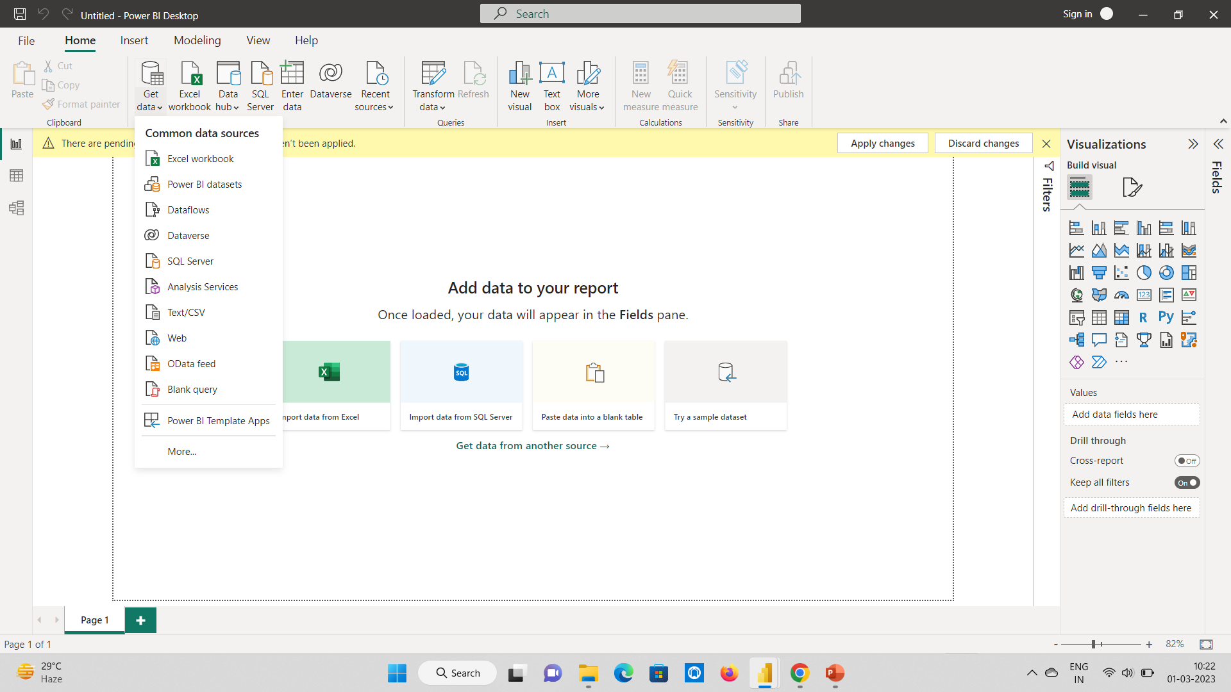
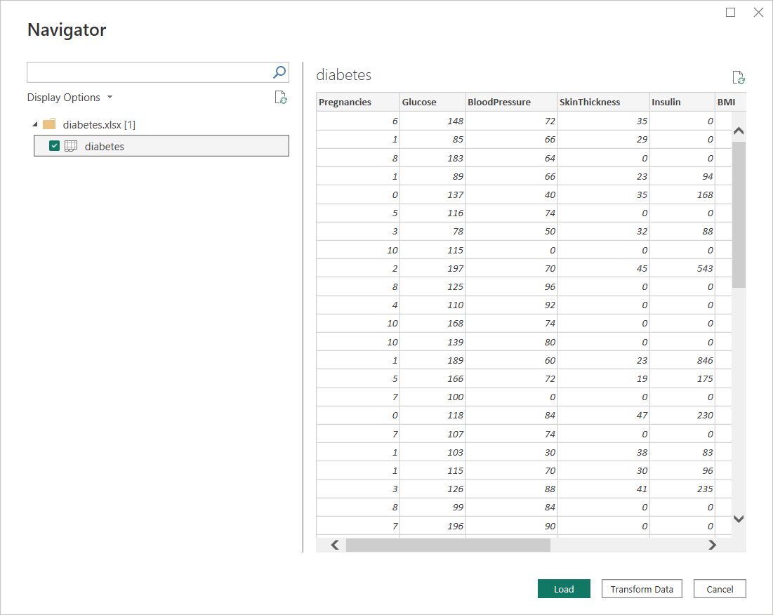
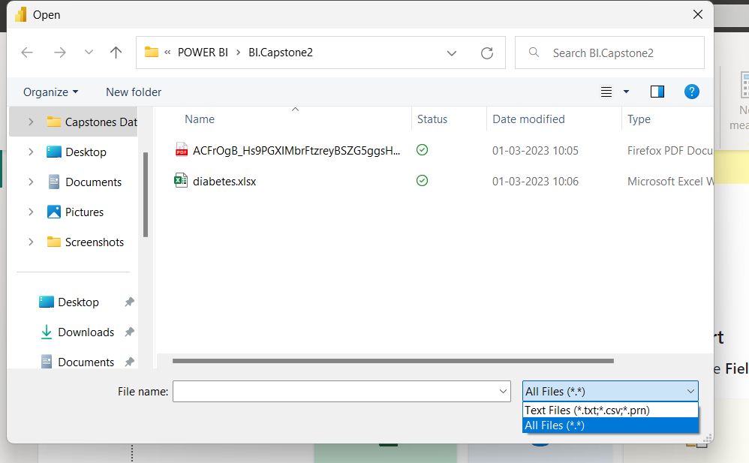
1)Import the given data into power BI?
Ans) In the home there is a ribbion Get data then select the data source type which type of file you importing .
Select Text/CSV then change textfiles to All files then we get the files to import then select the file and if we click on the transform data we can edit the data or if we click load then we directly import the data into power BI.

Slide 4
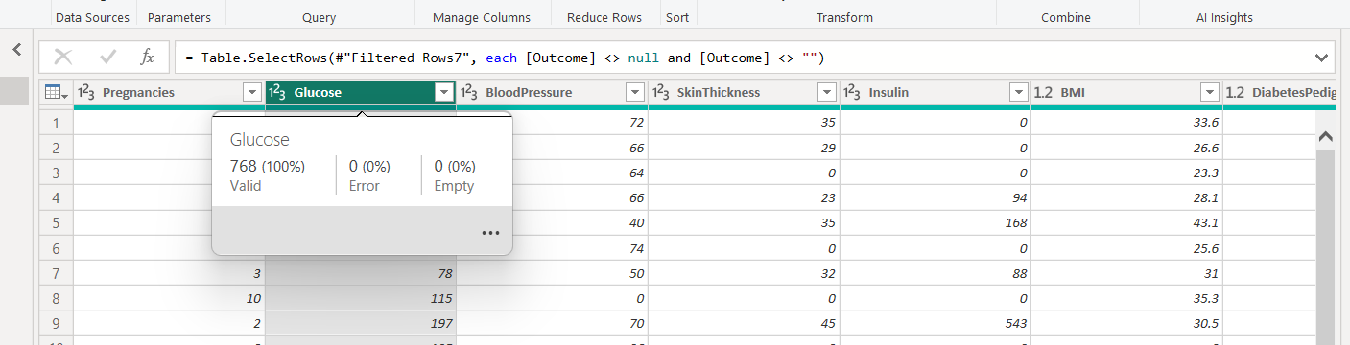
2) Check the Null and empty values and take that percentage and represent those values in the ppt?
Ans) The percentage of both null and empty is 0% there is no null and empty values in the given data .
we can see a green line below the column names if that line cut or the line is in red colour then we can see the empty or error values in that column, present the line is in green colour on all the columns then it represent there is no null and empty values in the given data.

Slide 5
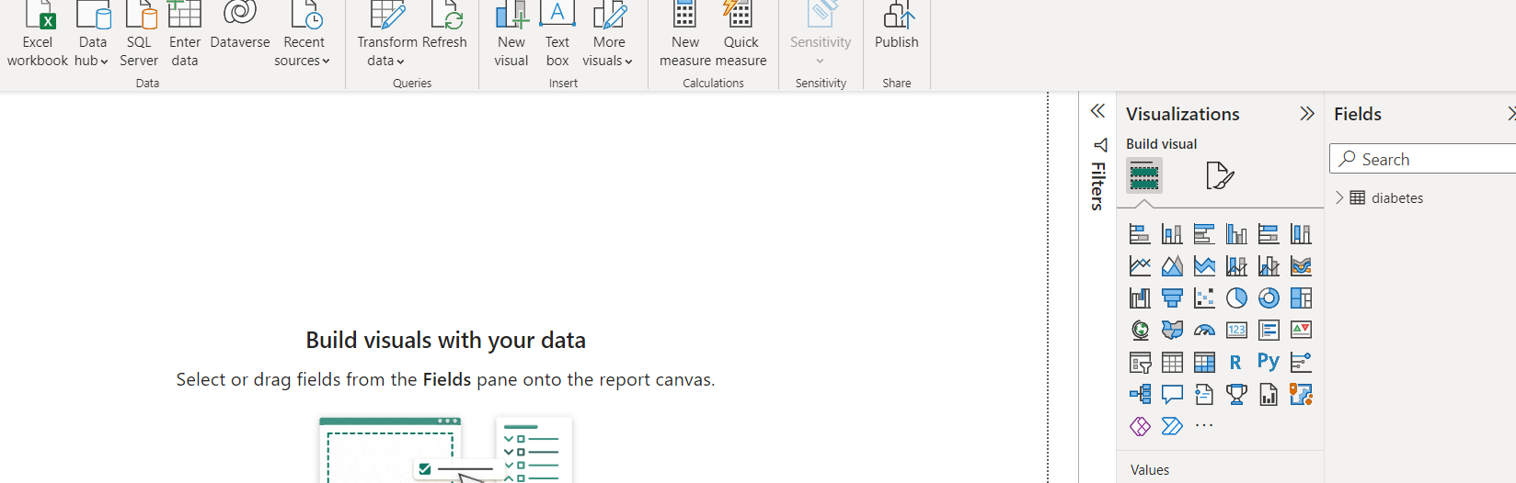
3) Remove all the nulls and errors from the data and load the data?
Ans) There is no null and errors in the data and then click on close and apply in the power query editor window we can directly load the data into power BI desktop window. We can see the load data in the right corner of the screen with Fields in the down of fields we can see the table diabetes.

Slide 6
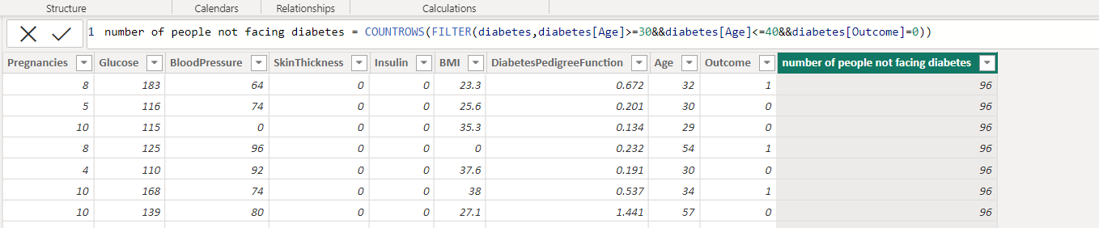
4) How many people are Not facing diabetes in the age group 30 to 40 from the given data?
Ans) From the given data 96 people are not facing diabetes in the age group 30 to 40 . The diabetespedigree function indicates the function which scores likelihood of diabetes based on family history ,age indicates the age of the person if the outcome be 0 then they don’t have diabetes otherwise they get 1 then they have diabetes. Here we use the DAX function to find the value in formula bar of model view.

Slide 7
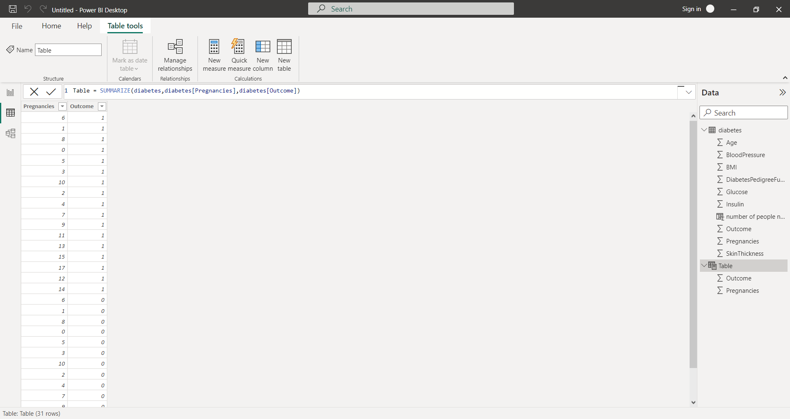
5) Create a table with columns pregnancies and outcomes ?
Ans) With the help of DAX function we can create new table.
In the data we can see the created table with column names.

Slide 8
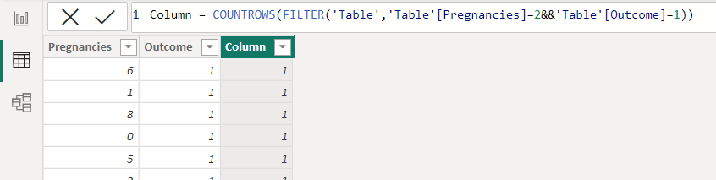
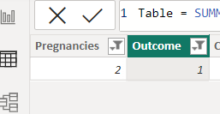
6) What percentage of women’s are facing diabetes with 2 pregnancies?
(Use table which is created in Question 5)
Ans) Only 1percentage of women are facing diabetes with 2 pregnancies.
To find this we can use DAX function or we can use filter option also.
Here column indicates the percentage of the womens who are facing diabetes with 2 pregnancies.
Here outcome 1 indicates the women facing diabetes.

Slide 9
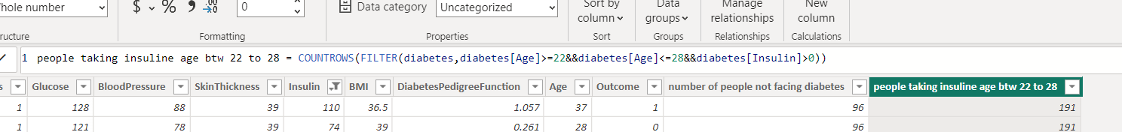
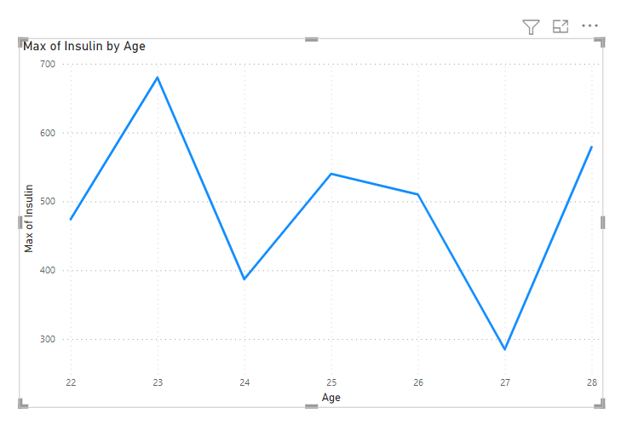
7) How many people are taking insulin in the age group 22 to 28 from the giving data and which age people are maximum from 22 to 28 (represent using line graph)?
Ans) 191 people are taking insulin in the age between 22 to 28 from the given data. 23 age group are the maximum people taking the insulin.

Slide 10
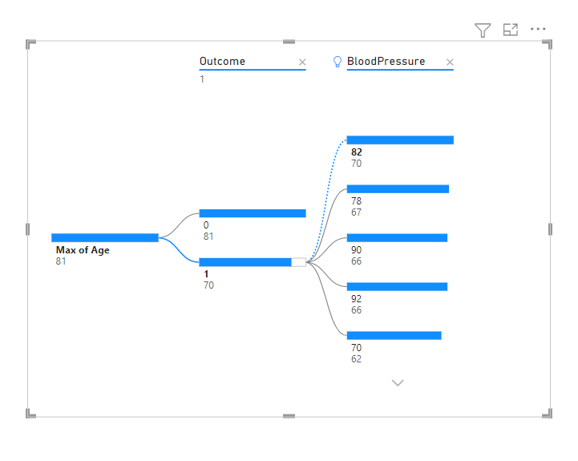
8) What is the age second maximum Number of people are facing diabetes along with blood pressure? (Represent with Decomposition tree)
Ans) At age 70 maximum number of people are facing diabetes along with blood pressure we can find this by filtereing the ages or we can get by decomposition tree.
Drag the age column in analyze , drag the outcome and bloodpressure in explainby then change the age into max of age and then click on plus symbol or expand the max of age , 1 indicates the people having diabetes and max 82 is the bloodpressure at age 70.

Slide 11
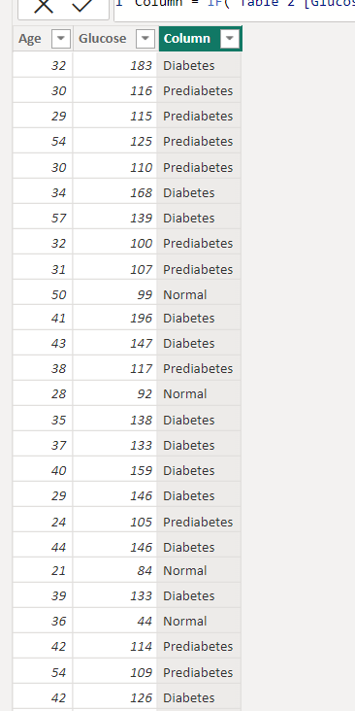
9) Create a table for age and glucose and add a column with the below conditions ?
0-99(Normal)
100-125(prediabetes)
126 and above(diabetes)
Ans) In the home click on the new table then create new table with the help of DAX function in the formula bar
Table 2 = SUMMARIZE(diabetes,diabetes[Age],diabetes[Glucose])
then create the new column with the given conditions by using
DAX function on formula bar in the model view.
Column =
IF('Table 2'[Glucose]>=126,"Diabetes",IF('Table 2'[Glucose]>=100&&'Table 2'[Glucose]<=125,"Prediabetes","Normal"))

Slide 12
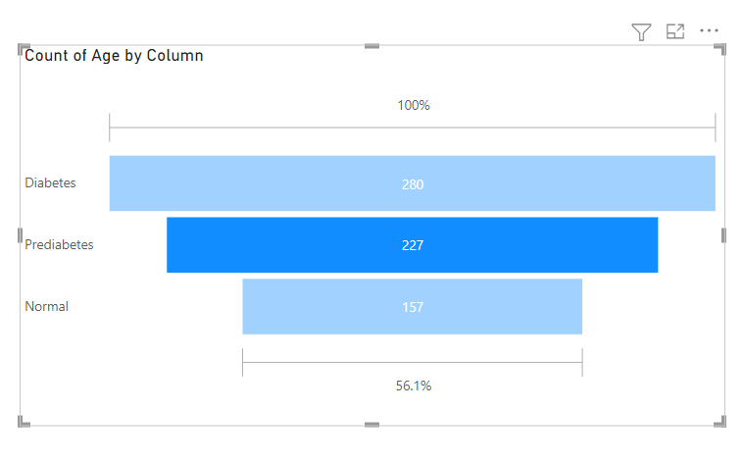
10) Create a visualization using the question 9 table and create a visualization using a funnel chart and how many people are suffering from prediabetes?
Ans) Using the before question table , select the funnel chart from the visulalization and drag the column from the table 2 into the category and drag age into the values and we want number of persons so we can change into count of ages from the funnel chart we can get the count of the people suffering from the prediabetes.
From the funnel chart ,227 people are suffering from prediabetes.

Slide 13
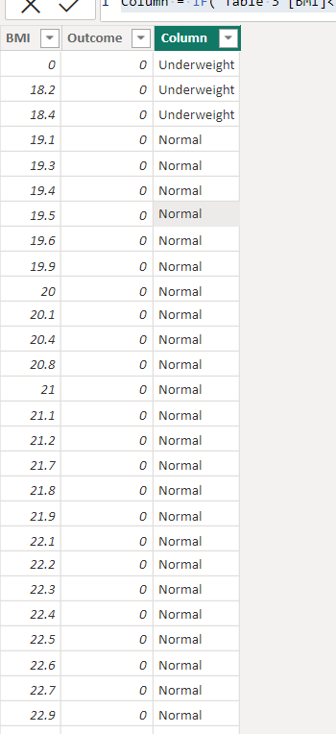
11) Create a table for BMI and outcome and add a column with the below conditions ?
(<18.50)Underweight
(18.50-24.99)Normal
(25.00-29.99)Overweight
(>=30.00)obese
Ans) With the help of DAX function we can create a new table
write the dax function on formula bar in the model view
Table 3 = SUMMARIZE(diabetes,diabetes[BMI],diabetes[Outcome])
After create table now create a new column with the given
conditions
Column = IF('Table 3'[BMI]<18.5,"Underweight",IF('Table 3'[BMI]>=18.50&&'Table 3'[BMI]<=24.99,"Normal",IF('Table 3'[BMI]>=25.00&&'Table 3'[BMI]<=29.99,"Overweight","Obese")))
In the picture we can see the created column under the given conditions.

Slide 14
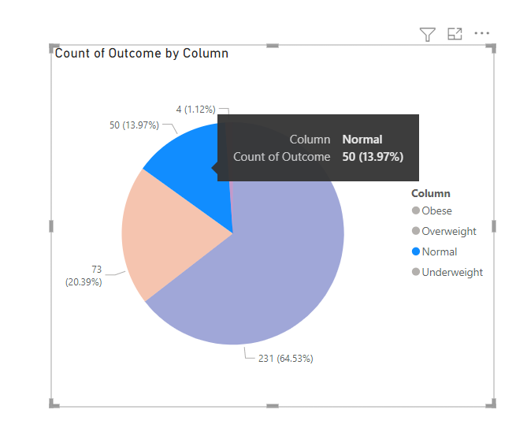
12)How many Normal people are suffering from diabetes from the following data and make a visualization using a pie chart?
Ans) 50 normal people are suffering with diabetes from the data , we can find the value by pie chart and also by filter the column with normal people then also we get the number of suffering people.
Select the pie chart from the visualization and drag the column in the legend and make count of outcome in the values, we drag the outcome because if they get 1 then that people are suffering with diabetes.
Here we can see the pie chart the normal people is
indicated by blue colour and also see that appears with
count and percentage .
50(13.97%) normal people are suffering with diabetes.

Slide 15

T
a
k
y
u
h
n
o

